Slide 1
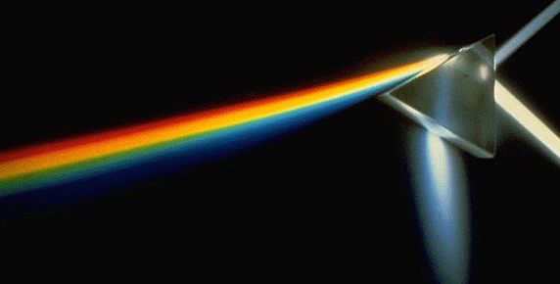
Introduction to Color
CS123 – Introduction to Computer Graphics
Notes:
- Video Non-linearity of HSV & RGB (video from ams, she has many copies
maybe try to find a copy that has narration and doesn't have a jumpy
picture)
- should have a CAVE color museum where they look at color spaces
- pantone slides (ams), additive color mixing
- color cube (from gfx), combined color mixing
- Exploratories (linked in lecture):
- metamers
- reflection
- rbg insuf
- single/triple cell
- subtractive color mixing
- wavelength filtering
- Gamma-Color- use images from 224 web page or elsewhere

Slide 2
Introduction
Graphics displays became common in the mid-60’s. The field of graphics concentrated first on interaction, and later on “photorealism” (which was generally based on performance-centered hacks)
Now both are important, as well as is non-photorealistic rendering (e.g., painterly or sketchy rendering)
Photorealistic rendering increasingly physically-based (such as using physically realistic values for light sources or surface reflectance) and perception-based
An understanding of the human visual and proprioceptive systems are essential to creating realistic user experiences

Slide 3
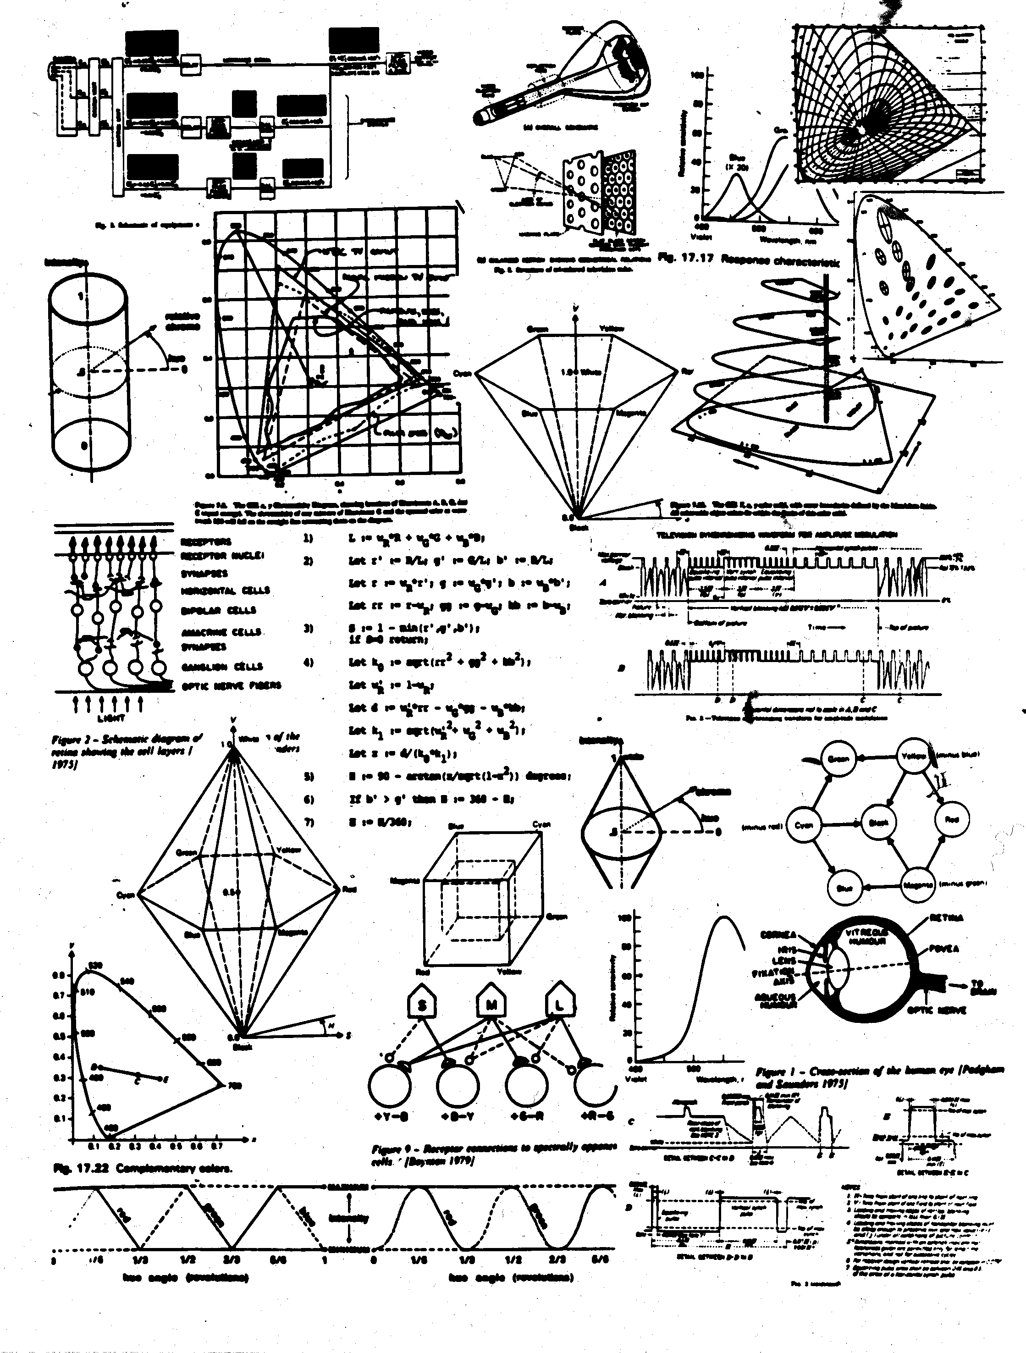
All You Need to Know About Color in CS123 (Courtesy of Barb Meier, former HeadTA)
Physics: E&M, optics, materials…
Electronics (display devices)
Psychophysics/Human Visual System
Graphical design

Slide 4
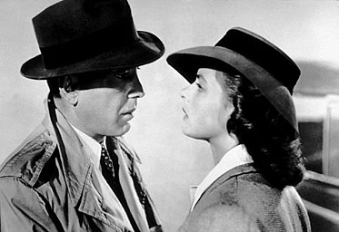
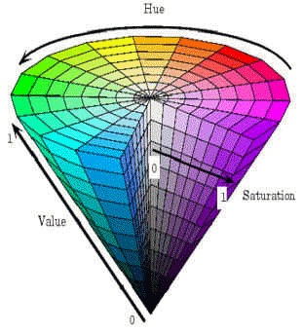
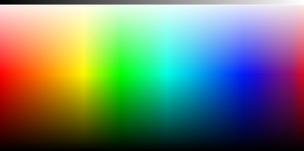
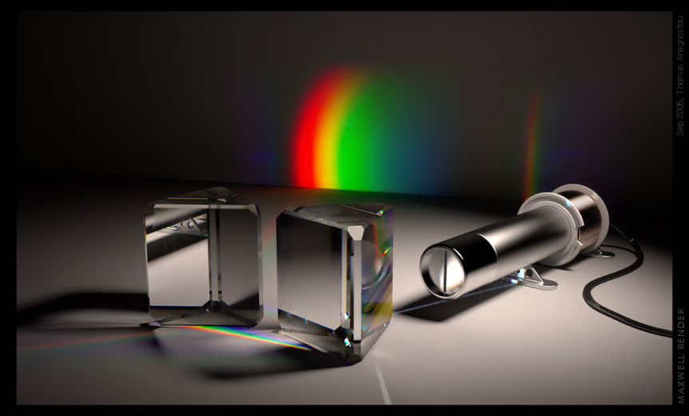
Lecture Roadmap
Motivation
Achromatic light
Chromatic color
Color models for raster graphics
Reproducing color
Using color in computer graphics
(rendered with
Maxwell)

Slide 5
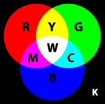
Why Study Color in Computer Graphics?
Measurement for realism - what does coding an RGB triple mean?
Aesthetics for selecting appropriate user interface colors
how to put on matching pants and shirt in the morning
what are the perceptual/physical forces driving one’s “taste” in color?
Understanding color models for providing users with easy color selection
systems for naming and describing colors
Color models, measurement and color gamuts for converting colors between media
why colors on your screen may not be printable, and vice-versa
managing color in systems that interface computers, screens, scanners, and printers together
Useful background for physically-based rendering and shares ideas with signal processing – photoreceptors process signals
Graphics group has worked on color tools for Adobe

Slide 6
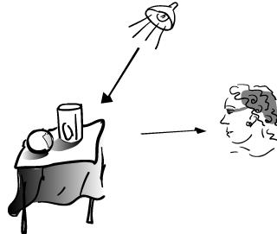
Why is Color Difficult?
Color is an immensely complex subject drawing from physics, physiology, perceptual psychology, art, and graphic design
There are many theories, measurement techniques, and standards for colors, yet no single theory of human color perception is universally accepted
Color of an object depends not only on the object itself, but also on the light sources illuminating it, the color of surrounding area, and on the human visual system (the eye/brain mechanism)
Some objects reflect light (wall, desk, paper), while others also transmit light (cellophane, glass)
surface that reflects only pure blue light illuminated with pure red light appears black
pure green light viewed through glass that transmits only pure red also appears black

Slide 7
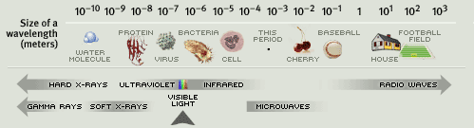
What is color?
Color is a property of objects that our minds create – an interpretation of the world around us
Color is apparently unique to humans and higher primates
Color perception stems from two main components:
Physical properties of the world around us
electromagnetic waves interact with materials in world and eventually reach eyes
visible light comprises the portion of the electromagnetic spectrum that our eyes can detect (380nm/violet – 740nm/red)
photoreceptors in the eye (rods and cones) convert light (photons) into electro-chemical signals which are then processed by our brains
Physiological interpretation of signals (“raw data”) output by receptors
less well-understood and incredibly complex higher level processing
very dependent on past experience and object associations
Both are important to understanding our sensation of color

Slide 8
Our Visual System Constructs our Reality (1/3)
Still not completely understood
Understanding our visual system and brain’s “wiring” is insufficient
New tools (e.g., fMRI) greatly increase our understanding, but also introduce new questions
Some viewing capabilities are hardwired, others are learned
We acquire a visual vocabulary
What looked real on the screen a few years ago no longer does – bar keeps rising
We have huge innate pattern recognition ability
Visual processing generally faster than higher-level cognitive processing
Roads use symbols instead of words for signs (but “dual coding” is always better)
And may have more emotional impact

Slide 9
Our Visual System Constructs our Reality (2/3)
Perceptual invariants are crucial for sense-making
Size, rotation and position constancy of objects despite varying projections on the eye (but not always!)
Color constancy despite changing wavelength distributions of illumination
Person recognition despite everything else changing and very poor viewing conditions
Optical illusions
Completing incomplete features, such as seeing “false” size differences due to context
Seeing differences in brightness due to context, negative afterimages, seeing “false” patterns and even motion
Seeing 3d (perspective, camera obscura, sidewalk art)
But also artifacts: misjudgments, vection (apparent motion)
Examples
Miscellaneous1, Miscellaneous2, Afterimages, Vection, Forced Perspective

Slide 10
Our Visual System Constructs our Reality (3/3)
Seeing is bidirectional
Visual process is semantically driven
Based on context, we expect to see (or not to see) certain things
Example
http://www.youtube.com/watch?v=Ahg6qcgoay4

Slide 11

Achromatic Light (1/2)
Achromatic Light: “without color,” quantity of light only
Called intensity, luminance, or measure of light’s energy/brightness
The psychophysical sense of perceived intensity
Gray levels (e.g., from 0.0 to 1.0)
We can distinguish approximately 128 gray levels
Seen on black and white displays
Note Mach banding/edge enhancement – stay tuned

Slide 12
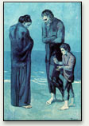
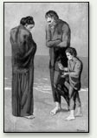
Achromatic Light (2/2)
Eye is much more sensitive to slight changes in luminance (intensity) of light than slight changes in color (hue)
"Colors are only symbols. Reality is to be found in luminance alone… When I run out of blue, I use red." (Pablo Picasso)
“Picasso's Poor People on the Seashore uses various shades of blue that differ from each other in luminance but hardly at all in color (hue). The melancholy blue color serves an emotional role, but does not affect our recognition of the scene.” Also, consider how realistic black and white images/movies look!
“The biological basis for the fact that color and luminance can play distinct roles in our perception of art, or of real life, is that color and luminance are analyzed by different subdivisions of our visual system, and these two subdivisions are responsible for different aspects of visual perception. The parts of our brain that process information about color are located several inches away from the parts that analyze luminance -- as anatomically distinct as vision is from hearing. ” (source below)
Source:
Includes in-depth explanations of many interesting natural phenomena relating to color (including several interactive applications) http://www.webexhibits.org/causesofcolor/
Notes:
NEW SLIDE

Slide 13
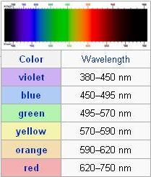
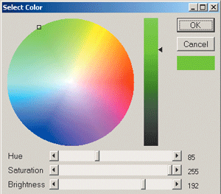
Chromatic Light
Factors of visual color sensations
Brightness / intensity(this circular color picker shows single brightness)
Chromaticity / color:
Hue / position in spectrum(red, green, …) - angle in polar coordinates (circular color picker)
Saturation / vividness – radius in polar coordinates (circular color picker)
Example of an HSV color picker
Ingredients of a Rainbow
Notes:
NEW SLIDE

Slide 14
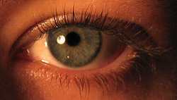
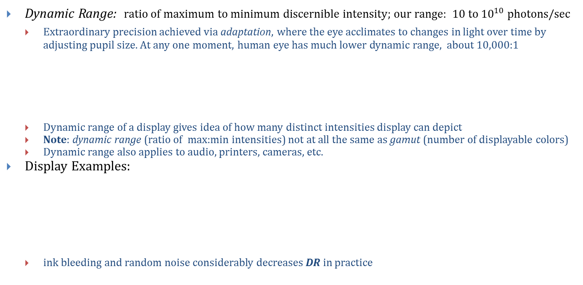
Dynamic Range
Dynamic Range: ratio of maximum to minimum discernible intensity; our range: $10 to {10}^{10}$photons/sec
Extraordinary precision achieved via adaptation, where the eye acclimates to changes in light over time by adjusting pupil size. At any one moment, human eye has much lower dynamic range, about 10,000:1
Dynamic range of a display gives idea of how many distinct intensities display can depict
Note: dynamic range (ratio of max:min intensities) not at all the same as gamut (number of displayable colors)
Dynamic range also applies to audio, printers, cameras, etc.
Display Examples:
ink bleeding and random noise considerably decreases DR in practice
Source: http://www.cambridgeincolour.com/tutorials/cameras-vs-human-eye.htm
Display Media | Dynamic Range
Apple Thunderbolt Display | 1000 : 1
CRT | 50-200 : 1
Photographic prints | 100 : 1
Photographic slides | 1000 : 1
Coated paper printed in B/W | 100 : 1
Coated paper printed in color | 50 : 1
Newsprint printed in B/W | 10 : 1

Slide 15
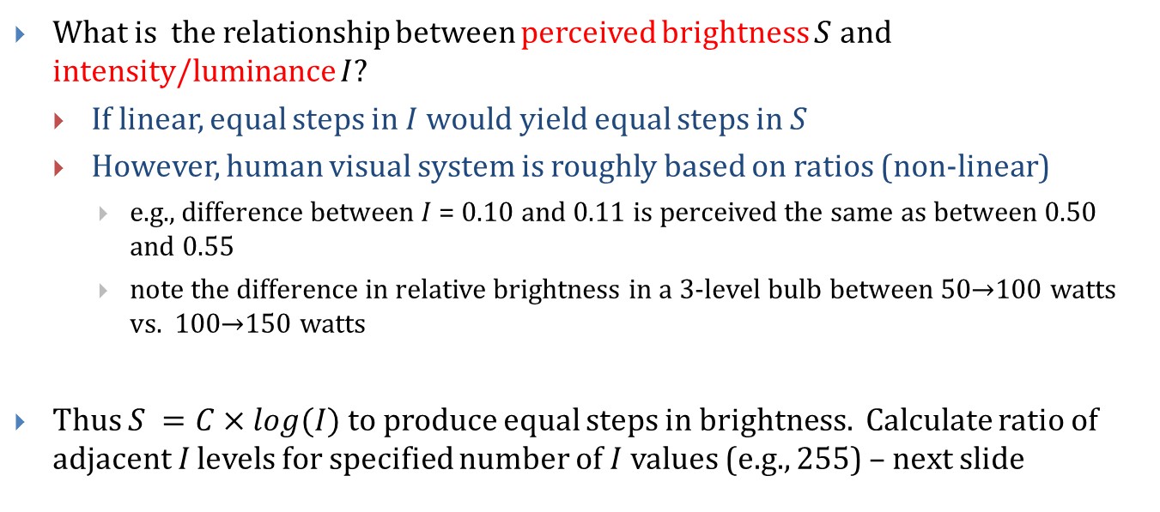
Non-linearity of Visual System (1/4)
What is the relationship between perceived brightness $S$ and intensity/luminance $I$?
If linear, equal steps in $I$ would yield equal steps in $S$
However, human visual system is roughly based on ratios (non-linear)
e.g., difference between $I$ = 0.10 and 0.11 is perceived the same as between 0.50 and 0.55
note the difference in relative brightness in a 3-level bulb between 50$→$100 watts vs. 100$→$150 watts
Thus $S =C×log(I)$to produce equal steps in brightness. Calculate ratio of adjacent $I$ levels for specified number of $I$ values (e.g., 255) – next slide

Slide 16
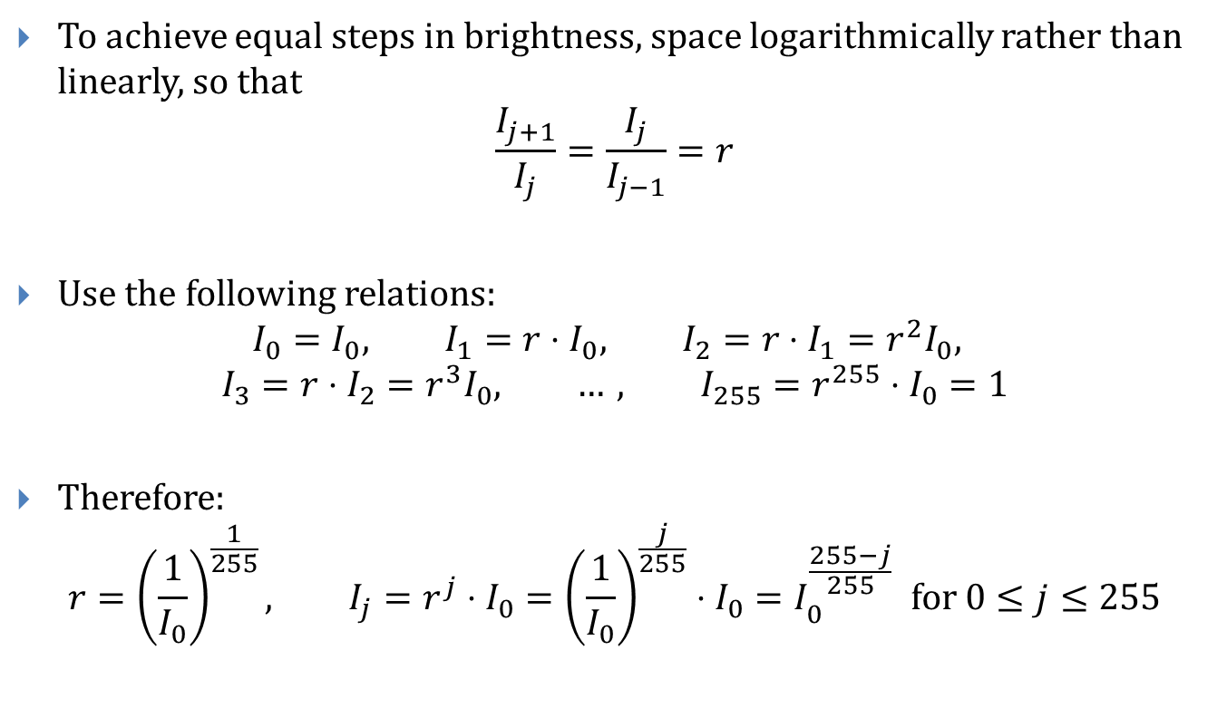
Non-linearity of Visual System (2/4)
To achieve equal steps in brightness, space logarithmically rather than linearly, so that
$$\frac{I_{j+1}}{I_{j}}=\frac{I_{j}}{I_{j−1}}=r$$
Use the following relations:
$$I_{0}=I_{0}, I_{1}=r⋅I_{0}, I_{2}=r⋅I_{1}=r^{2}I_{0},$$
$$I_{3}=r⋅I_{2}=r^{3}I_{0}, …, I_{255}=r^{255}⋅I_{0}=1$$
Therefore:
$$r={\left(\frac{1}{I_{0}}\right)}^{\frac{1}{255}}, I_{j}=r^{j}⋅I_{0}={\left(\frac{1}{I_{0}}\right)}^{\frac{j}{255}}⋅I_{0}=I_{0}^{\frac{255−j}{255}} for 0≤j≤255$$

Slide 17
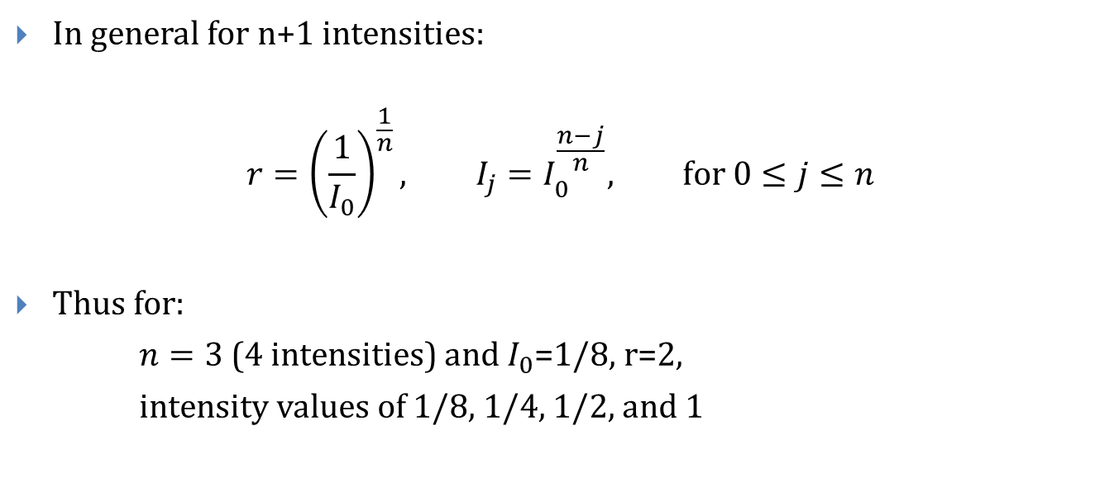
Non-linearity of Visual System (3/4)
In general for n+1 intensities:
$$r={\left(\frac{1}{I_{0}}\right)}^{\frac{1}{n}}, I_{j}=I_{0}^{\frac{n−j}{n}}, for 0≤j≤n$$
Thus for:
$n=3$(4 intensities) and $I_{0}$=1/8, r=2,
intensity values of 1/8, 1/4, 1/2, and 1

Slide 18
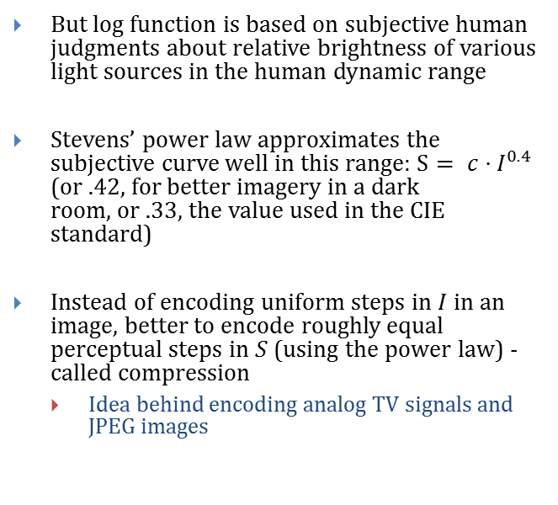
Non-linearity of Visual System (4/4)
But log function is based on subjective human judgments about relative brightness of various light sources in the human dynamic range
Stevens’ power law approximates the subjective curve well in this range: $S= c⋅I^{0.4}$ (or .42, for better imagery in a dark room, or .33, the value used in the CIE standard)
Instead of encoding uniform steps in $I$ in an image, better to encode roughly equal perceptual steps in $S$ (using the power law) - called compression
Idea behind encoding analog TV signals and JPEG images
Notes:
18

Slide 19
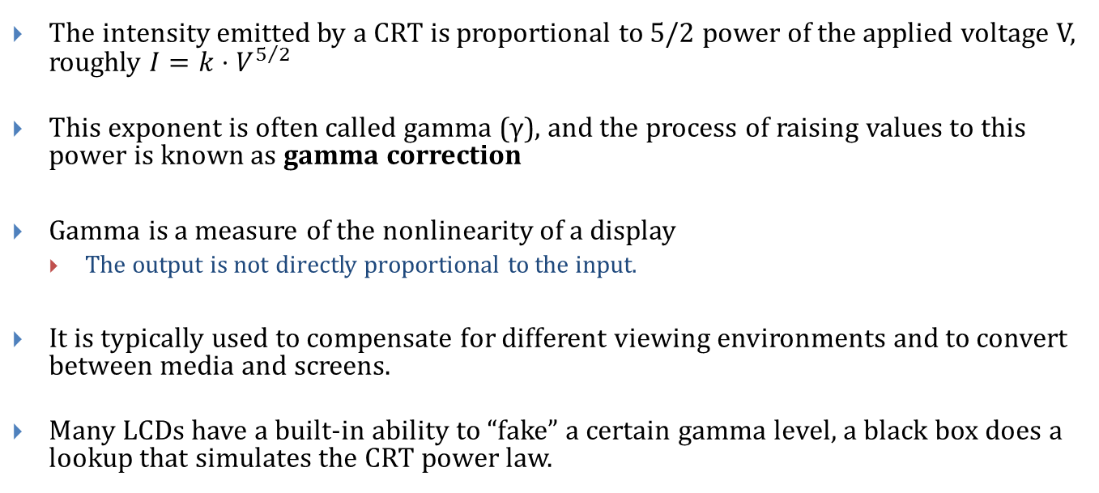
Non-linearity in Screens: Gamma
The intensity emitted by a CRT is proportional to 5/2 power of the applied voltage V, roughly $I=k⋅V^{5/2}$
This exponent is often called gamma (γ), and the process of raising values to this power is known as gamma correction
Gamma is a measure of the nonlinearity of a display
The output is not directly proportional to the input.
It is typically used to compensate for different viewing environments and to convert between media and screens.
Many LCDs have a built-in ability to “fake” a certain gamma level, a black box does a lookup that simulates the CRT power law.

Slide 20
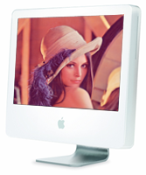
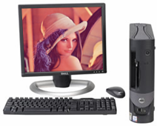
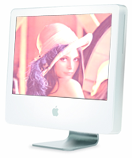
Gamma
Example: PC monitors have a gamma of roughly 2.5, while Mac monitors have a gamma of 2.2, so Mac images appear dark on PC’s
Problems in graphics:
Need to maintain color consistency across different platforms and hardware devices (monitor, printer, etc.)
Even the same type/brand of monitors change gamma values over time
Mac user generates image
PC user changes image to make it bright
PC user gives image back; it’s now too bright

Slide 21
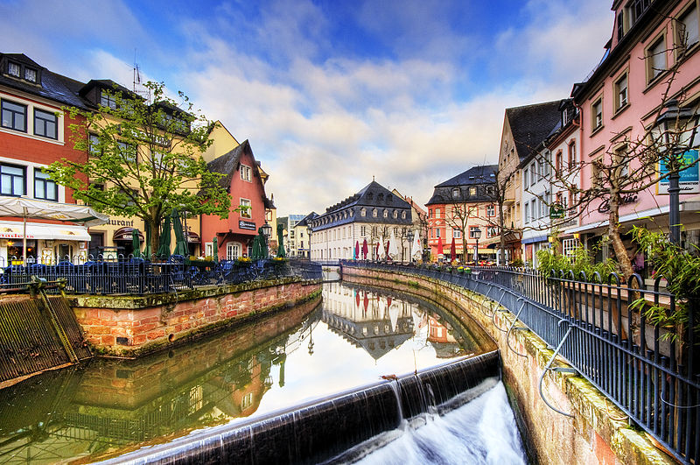
High Dynamic Range (1/3)
High Dynamic Range (HDR): describes images and display media that compress the visible spectrum to allow for greater contrast between extreme intensities
Takes advantage of nonlinearities inherent in perception and display devices to compress intensities in an intelligent fashion
Allows a display to artificially depict an exaggerated contrast between the very dark and very bright
http://en.wikipedia.org/wiki/High_dynamic_range_imaging

Slide 22
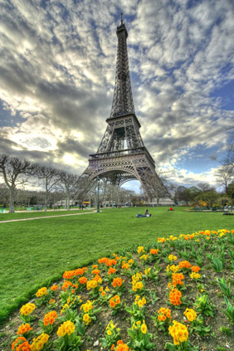
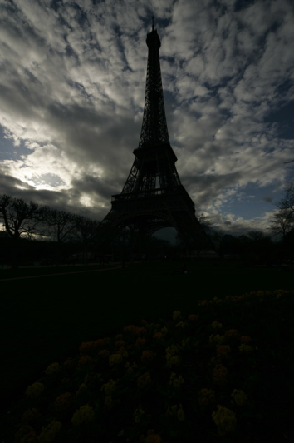
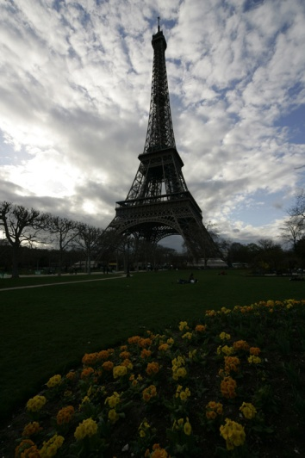
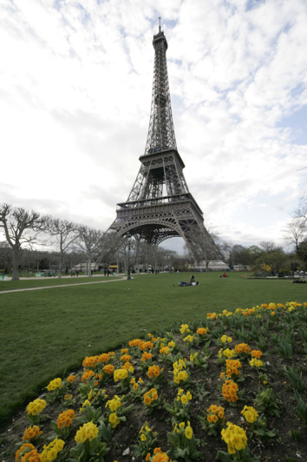
High Dynamic Range (2/3)
Can combine photos taken at different exposure levels into an aggregate HDR image with more overall contrast (higher dynamic range)
Generally 32-bit image format (e.g., OpenEXR or RGBE)
HDR and tone mapping are hot topics in rendering!
(source: www.hdrsoft.com)

Slide 23
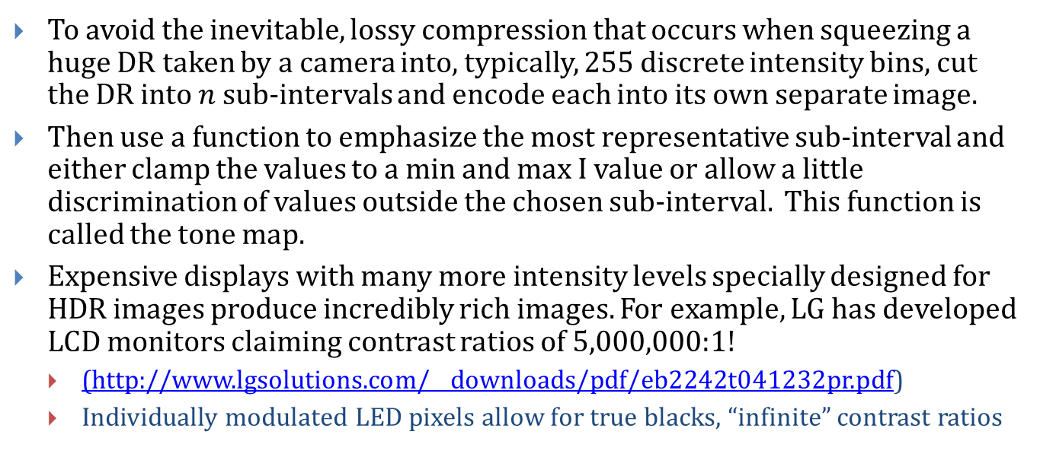
High Dynamic Range (3/3)
To avoid the inevitable, lossy compression that occurs when squeezing a huge DR taken by a camera into, typically, 255 discrete intensity bins, cut the DR into $n$ sub-intervals and encode each into its own separate image.
Then use a function to emphasize the most representative sub-interval and either clamp the values to a min and max I value or allow a little discrimination of values outside the chosen sub-interval. This function is called the tone map.
Expensive displays with many more intensity levels specially designed for HDR images produce incredibly rich images. For example, LG has developed LCD monitors claiming contrast ratios of 5,000,000:1!
(http://www.lgsolutions.com/__downloads/pdf/eb2242t041232pr.pdf)
Individually modulated LED pixels allow for true blacks, “infinite” contrast ratios

Slide 24
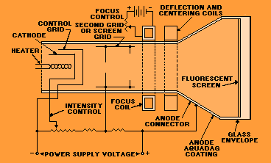
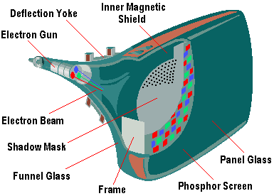
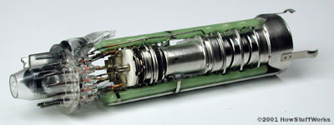
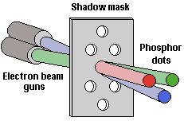
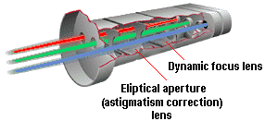
Inside a CRT
Phosphor's light output decays exponentially; thus refresh at >= 60Hz
Cool pictures: http://www.pctechguide.com/06crtmon.htm
Block diagram : http://www.tpub.com/neets/book18/

Slide 25
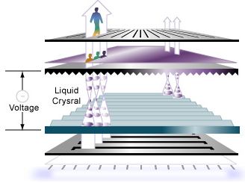
Inside an LCD
Backlight made by LEDs and diffuser layer provides (whitish) flood lighting of entire screen
Polarizer filters light, allows only certain light with desired direction to pass
TFT matrix: transistors and capacitors at each pixel to change the voltage that bends the light
Liquid Crystal controls direction of light, allow between 0 and 100% through second polarizer
Color Filter gives each subpixel in (R,G,B) triad its color. Subpixel addressing used in anti-aliasing
Video: http://www.youtube.com/watch?v=jiejNAUwcQ8
Picture source http://www.teac.com.au/pages/howdoesanlcdwork

Slide 26
Color Terms
Hue distinguishes among colors (e.g., red, green, purple, and yellow)
Saturation refers to how pure the color is, how much white/gray is mixed with it
red saturated; pink unsaturated
royal blue saturated; sky blue unsaturated
Pastels are less vivid and less intense
Lightness: perceived achromatic intensity of reflecting object
Brightness: perceived intensity of a self-luminous object, such as a light bulb, the sun, or an LCD screen
Can distinguish ~7 million colors when samples placed side-by-side (JNDs – Just Noticeable Differences)
With differences only in hue, differences of JND colors are 2nm in the central part of visible spectrum and10 nm at extremes – non-uniformity!
About 128 fully saturated hues are distinct
Eye are less discriminating for less saturated light and less sensitive for less bright light

Slide 27

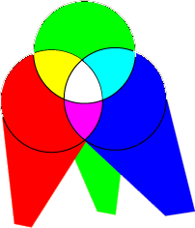
Color Mixture
A B
The effect of (A) passing light through several filters (subtractive mixture), and (B) throwing different lights upon the same spot (additive mixture)
Color Mixing Applets
Additive Mixing Applet:
http://www.cs.brown.edu/exploratories/freeSoftware/repository/edu/brown/cs/exploratories/applets/colorMixing/additive_color_mixing_guide.html
Combined Mixing Applet:
http://www.cs.brown.edu/exploratories/freeSoftware/repository/edu/brown/cs/exploratories/applets/combinedColorMixing/combined_color_mixing_guide.html
Notes:
Changed additive and subtractive color images, removed citation of Gleitman’s Psychology

Slide 28
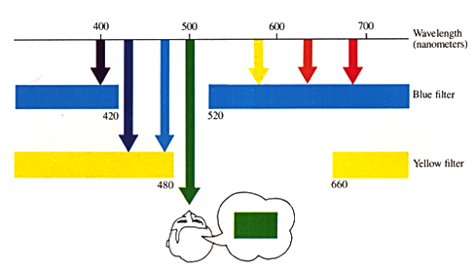
Subtractive Mixture
Subtractive mixture occurs when mixing paints, dyes, inks, etc. that act as a filters between the viewer and the light source / reflective surface.
In subtractive mixing, the light passed by two filters (or reflected by two mixed pigments) are wavelengths that are passed by the two filters
On left: first filter passes 420 - 520 nanometers (broad-band blue filter), while second passes 480 - 660 nanometers (broad-band yellow filter). Light that can pass through both is in 480 - 520 nanometers, which appears green.
blue green yellow red
green

Slide 29
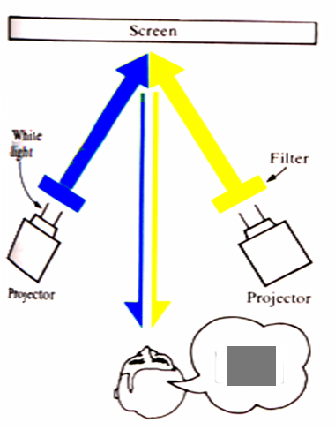
Additive Mixture
Additive mixture occurs when color is created by mixing visible light emitted from light sources
Used for computer monitors, televisions, etc.
Light passed by two filters (or reflected by two pigments) impinges upon same region of retina.
On left: pure blue and yellow filtered light on same portion of the screen, reflected upon same retinal region.

Slide 30
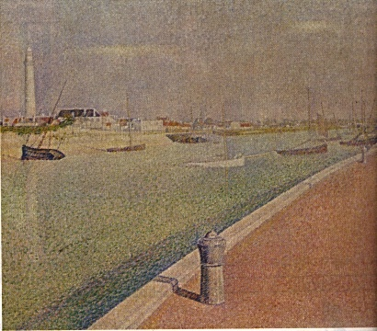
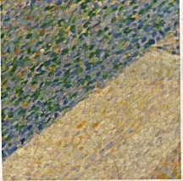
Additive Mixture in Pointillist Art
The Channel at Gravelines (1890) by Georges Seurat
Discrete color daubs (left image) are said to mix additively at a distance.
Pointillist technique
Creates bright colors where mixing(overlaying) daubs darkens (subtractive)
Sondheim’s “Sunday in the Park with George” is a fantastic modern musical exploring Seurat’s color use and theories about light, color, composition.

Slide 31
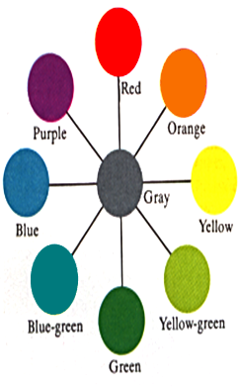
Complementary Hues – Additive Mixture
Complementary hues: Any hue will yield gray if additively mixed in correct proportion with it’s opposite hue on the color circle. Such hue pairs are complementary. Of particular importance are the pairs that contain four unique hues: red-green, blue-yellow “complementary hues”
These “unique” hues play a role in opponent color perception discussed later
Note that only for perfect red and green do you get gray – CRT red and green both have yellow components and therefore sum to yellowish gray
Notes:
Aligned color wheel with rest of slide

Slide 32
Color Contrast
The gray patches on the blue and yellow backgrounds are physically identical, yet look different
Difference in perceived brightness: patch on blue background looks brighter than one on yellow. Result of brightness contrast.
Also a difference in perceived hue. Patch on blue looks yellowish, while patch on yellow looks bluish. This is color contrast: hues tend to induce their complementary colors in neighboring areas.
To explore, click any Albers Plate link on: http://www.cs.brown.edu/courses/cs092/VA10/HTML/start.html

Slide 33
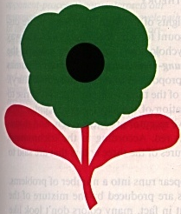
Negative Afterimage
Stare at center of figure for about a minute or two, then look at a blank white screen or a white piece of paper
Blink once or twice; negative afterimage will appear within a few seconds showing the rose in its “correct” colors (red petals and green leaves)

Slide 34
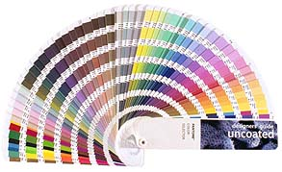
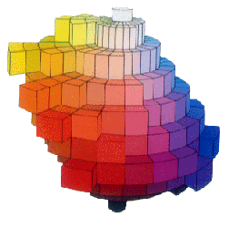
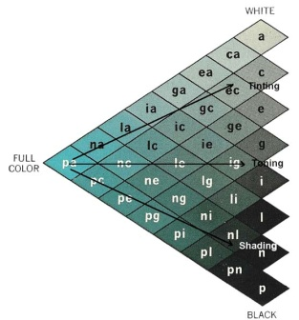
Specifying (Naming) Color
How to refer to or name a particular color?
Compare unknown and sample from a collection
Colors must be viewed under a standard light source
Depends on human judgment
PANTONE® Matching System
in printing industry
Munsell color system
Set of samples in 3D space
Dimensions are for: hue, lightness, and saturation
Equal perceived distances
between neighboring samples
Artists specify color as tint, shade, tone
using pure white and black pigments
Ostwald system is similar
Later, we’ll look at computer-based
models
Decrease saturation
White
Tints
“Pure” color
Tones
Grays
Decrease
lightness
Shades
Black

Slide 35
Psychophysics
Tint, shade, and tone: subjective and depend on observer’s judgment, lighting, sample size, context, etc
Colorimetry: quantitative with measurements made via spectroradiometer (measures reflected/radiated light), colorimeter (measures primary colors), etc.
Perceptual term Colorimetry term
Hue Dominant wavelength
Saturation Excitation purity
Lightness (reflecting objects) Luminance
Brightness (self-luminous objects) Luminance
Physiology of vision, theories of perception still active research areas
Note: our auditory and visual processing are very different!
both are forms of signal processing
visual processing integrates/much more affected by context
more than half of our cortex devoted to vision
vision probably dominant sense, though it is apparently harder to be deaf than blind

Slide 36
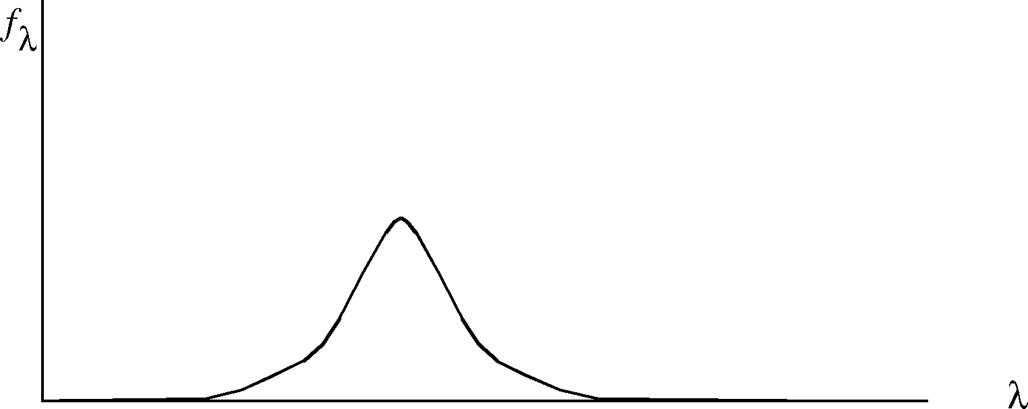
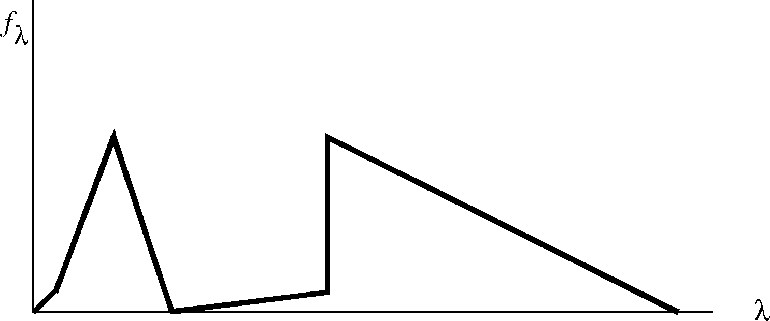
Response to Stimuli (1/3)
We draw a frequency response curve like this:
to indicate how much a photoreceptor responds to light of uniform intensity for each wavelength
To compute response to incoming band (frequency distribution) of light, like this:
We multiply the curves, wavelength by wavelength, to compute receptor response to each amount of stimulus across spectrum
ƒ(λ)
λ
Ι (λ)
λ

Slide 37
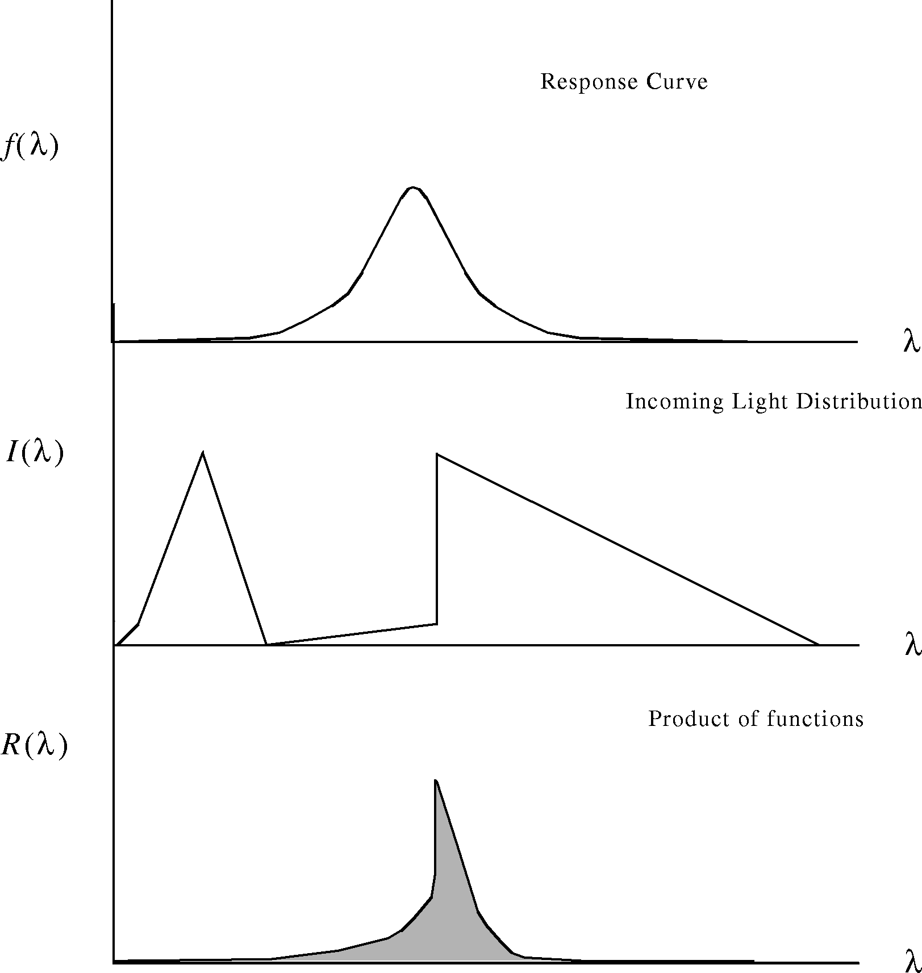
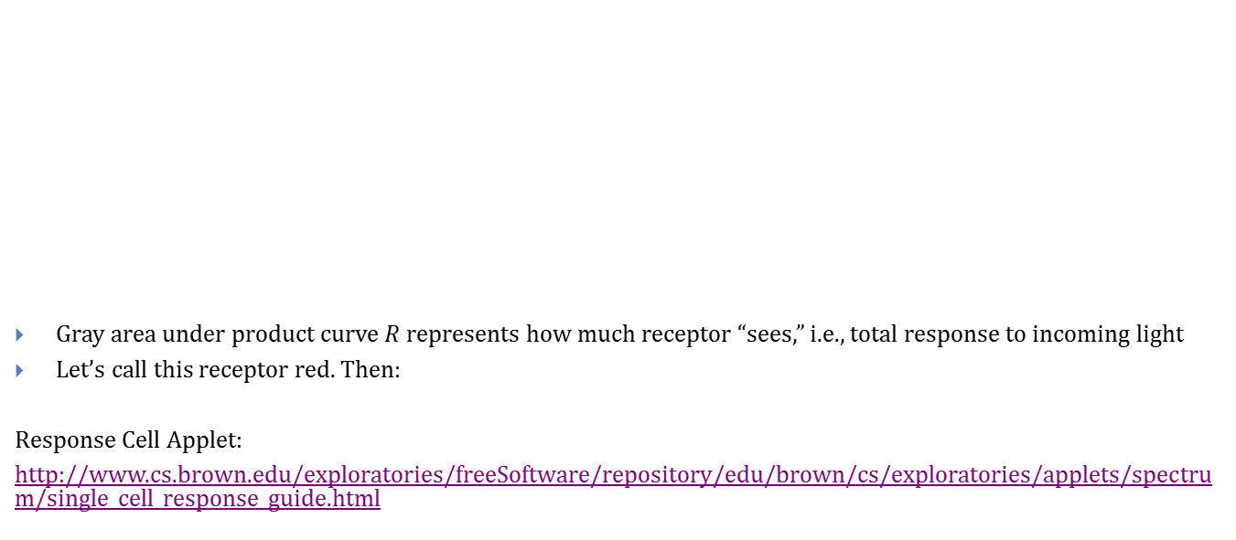
Response to Stimuli (2/3)
Gray area under product curve $R$ represents how much receptor “sees,” i.e., total response to incoming light
Let’s call this receptor red. Then:
Response Cell Applet:
http://www.cs.brown.edu/exploratories/freeSoftware/repository/edu/brown/cs/exploratories/applets/spectrum/single_cell_response_guide.html
Response Curve
f
(
λ
)
λ
Incoming Light Distribution
I
(
λ
)
λ
Product of functions
R
(
λ
)
λ
red perception = ∫ R(λ)d(λ) = ∫ I(λ)f(λ)dλ

Slide 38
Response to Stimuli (3/3)
Response curve also called filter because it determines amplitude of response (i.e., perceived intensity) for each wavelength
Where filter’s amplitude is large, filter lets through most of incoming signal → strong response
Where filter’s amplitude is low, filters out much or all of signal → weak response
Analogous to filtering that you saw in the Image Processing Unit

Slide 39
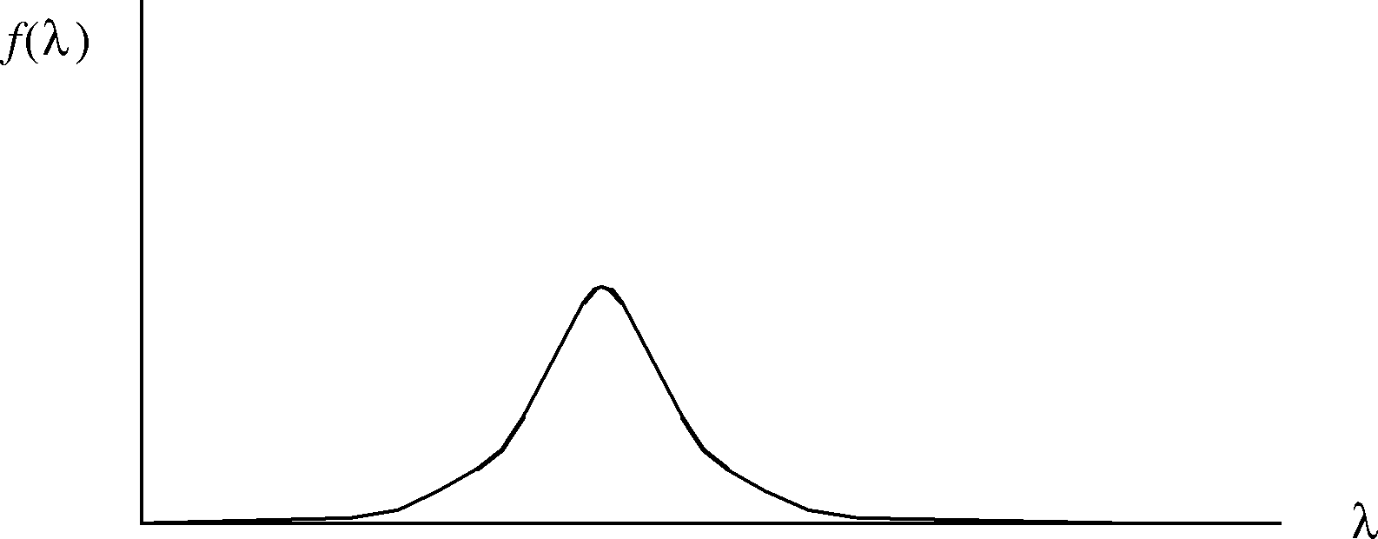

Metamers (1/3)
Different light distributions that produce the same response
Imagine a creature with one receptor type (“red”) with response curve like this:
How would it respond to each of these two light sources?
Both signals will generate same amount of “red” perception. They are metamers
one receptor type cannot give more than one color sensation (albeit with varying brightness)
ƒ(λ)
λ
ƒ(λ)
λ

Slide 40


Metamers (2/3)
Consider a creature with two receptors (R1, R2)
Both $I_{1}$ and $I_{2}$ are processed by (convolved with) the receptors $R_{1}$ and $R_{2}$ to form the same product
Note that in principle, an infinite number of frequency distributions can simulate the effect of $I_{2}$, e.g., $I_{1}$
in practice, near tails of response curves, amount of light required becomes impractically large
I₁
I₂
I₁
R₁
R₂

Slide 41
Metamers (3/3)
Whenever you have at least two receptors, there are potentially infinite color distributions that will generate identical sensations (metamers)
Conversely, no two monochromatic lights can generate identical receptor responses - they all look unique
Observations:
If two people have different response curves, they will have different metamers
Different people can distinguish between different colors
Metamers are purely conceptual
Scientific instruments can detect difference between two metameric lights
Metamer Applet:
http://www.cs.brown.edu/exploratories/freeSoftware/repository/edu/brown/cs/exploratories/applets/spectrum/metamers_guide.html

Slide 42

Energy Distribution and Metamers
Spectral color: color evoked from single wavelength; “ROYGBIV” spectrum
Non-spectral color: combination of spectral colors; can be shown as continuous spectral distribution or as discrete sum of n primaries (e.g., R, G, B); most colors are non-spectral mixtures. N.B. No finite number of primaries can produce
Metamers are spectral energy distributions perceived as same “color”
Each color sensation can be produced by arbitrarily large number of metamers
White light spectrum where height of curve is spectral energy distribution
Cannot predict average observer’s color sensation from a distribution!

Slide 43

Colorimetry Terms
Can characterize visual effect of any spectral distribution by triple (dominant wavelength, excitation purity, luminance):
Dominant wavelength: hue we see; the spike of energy e2
Excitation purity: “saturation,” ratio of monochromatic light of dominant wavelength to white light
Luminance: relates to total energy, proportional to $\int{intensity distribution ∗eye^{′}s response curve}$ $\left(\text{luminous} \text{efficiency} \text{function}\right),$ depends on both e1 and e2.
Note:
dominant wavelength of real distribution may not be one with largest amplitude!
some colors (purple) have no dominant wavelength
Dominant Wavelength
Energy Density
e₂
Idealized uniform distribution except for e₂
e₁
400
Wavelength,nm
700

Slide 44
Three Layers of Human Color Perception - Overview
Receptors in retina (for color matching)
Rods, three types of cones (tristimulus theory)
Primary colors (only three used for screen images: approximately (non-spectral) red, green, blue (RGB))
Note: receptors each respond to wide range of frequencies, not just spectral primaries
Opponent channels (for perception)
Other cells in retina and neural connections in visual cortex
Blue-yellow, red-green, black-white
4 psychological color primaries*: red, green, blue, and yellow
Opponent cells (also for perception)
Spatial (context) effects, e.g., simultaneous contrast, lateral inhibition
* These colors are called “psychological primaries” because each contains no perceived element of others regardless of intensity.

Slide 45
Receptors in Retina
Receptors contain photopigments that produce electro-chemical response
Rods (scotopic): only see grays, work in low-light/night conditions, mostly in periphery
Cones (photopic): respond to different wavelengths to produce color sensations, work in bright light, densely packed near center of retina (fovea), fewer in periphery
Young-Helmholtz tristimulus theory¹: 3 cone types in the eye, each of which is most sensitive to a particular range of visible light, with roughly a normal distribution
Three receptor types can produce a gamut of colors that are contained in a 3-space of hue, saturation and value (lightness/brightness)
To avoid overly literal interpretation of R,G, B, perceptual psychologists often use S (short), I (intermediate), L (long) as a measure of wavelength instead
¹Thomas Young proposed idea of three receptors in 1801. Hermann von Helmholtz looked at theory from a quantitative basis in 1866. Although they did not work together, the theory is called the Young-Helmholtz theory since they arrived at same conclusions.

Slide 46


Tristimulus Theory
Tristimulus theory does not explain subjective color perception, e.g., not many colors look like predictable mixtures of RGB (violet looks like red and blue, but what about yellow?)
The luminous efficiency function on right is the sum of the three spectral response functions on the left and gives the total response of the eye to each wavelength
Spectral response functions
Luminous efficiency function
Triple Cell Response Applet http://www.cs.brown.edu/exploratories/freeSoftware/repository/edu/brown/cs/exploratories/applets/spectrum/triple_cell_response_guide.html

Slide 47

Hering’s Chromatic Opponent Channels
Additional neural processing
Three receptor elements have excitatory and inhibitory connections with neurons higher up that correspond to opponent processes
One pole is activated by excitation, the other by inhibition
All colors can be described in terms of 4 “psychological color primaries” R, G, B, and Y
However, a color is never reddish-greenish or bluish-yellowish: idea of two “antagonistic” opponent color channels, red-green and yellow-blue
Light of 450 nm
S
I
L
- + +
+ - +
+ + +
Y-B
R-G
BK-W
Each channel is a weighted sum of receptor outputs – linear mapping
Hue: Blue + Red = Violet

Slide 48
Spatially Opponent Cells
Some cells in opponent channels are also spatially opponent, a type of lateral inhibition (called double-opponent cells)
Responsible for effects of simultaneous contrast and after images
green stimulus in cell surround causes some red excitement in cell center, making gray square in field of green appear reddish
Plus…
color perception strongly influenced by context, training, etc., abnormalities such as color blindness (affects about 8% of males, 0.4% of females)

Slide 49


Mach Bands and Lateral Inhibition
A
B
Mach bands: illusion in which stripes are perceived next to the boundary between two regions of an image having different lightness gradients
Nature provides for contrast enhancement at boundaries between regions: edge detection. This is caused by lateral inhibition.
Notes:
Replaced Lateral Inhibition Graph to more clearly correspond to Mach Band example

Slide 50


Lateral Inhibition and Contrast
Lateral Inhibition: Excited cell can reduce activity of its neighbors
Receptor cells, A and B, stimulated by neighboring regions of stimulus.
A receives moderate light. A’s excitation stimulates next neuron on visual chain, cell D, which transmits message toward brain.
Transmission impeded by cell B, whose intense excitation inhibits cell D. Cell D fires at reduced rate.
Intensity of cell $c_{j}=I(c_{j})$is function of $c_{j}$’s excitation e($c_{j}$) inhibited by its neighbors with attenuation coefficients $a_{k}$ that decrease with distance. Thus,
$$I\left(C_{j}\right)=e\left(c_{j}\right)−\sum_{k≠j}{a_{k}e\left(c_{k}\right)}$$
At boundary more excited cells inhibit their less excited neighbors even more and vice versa. Thus, at boundary dark areas even darker than interior dark ones, light areas are lighter than interior light ones.
Nature’s edge detection
excite
inhibit

Slide 51

Color Matching (1/3)
Need way to describe colors precisely for industry and science
Tristimulus Theory makes us want to describe all visible colors in terms of three variables (to get 3D coordinate space) vs. infinite number of spectral wavelengths or special reference swatches…
Choose three well-defined light colors to be the three variables/”primaries” (R, G, B)
People sit in a dark room matching colors

Slide 52



Color Matching (2/3)
But any three primaries R, G and B can’t match all visible colors (for reasons we’ll be exploring soon)
Sometimes need to add/subtract some R to sample you are trying to match.
0 250 20
50 220 200
40 0 0
Try for yourself! Try matching target color with λ = 500. Impossible to do so by only adding R, G, and B: http://graphics.stanford.edu/courses/cs178/applets/colormatching.html

Slide 53


Color Matching (3/3)
Color-matching functions, showing amounts of three primaries needed by average observer to match a color of constant luminance, for all values of dominant wavelength in visible spectrum.
Note: these are NOT response functions! (and they have non-zero tails)
Negative value of r$ed f$ => cannot match, must “subtract,” i.e., add that amount to unknown
Mixing positive amounts of arbitrary R, G, B primaries provides large color gamut, e.g., display devices, but no device based on a finite number of primaries can show all colors! (as we’ll see, n primaries define a convex hull which can’t cover the visible gamut)

Slide 54


Mathematical CIE Space for Color Matching
Having to use negative amount of primaries is awkward
Commission Internationale de l´Éclairage (CIE) defined mathematical X, Y, and Z primaries to replace R, G, B – can map to and from X, Y, Z to R, G, B
x_{λ}, y_{λ}, and z_{λ}, color matching functions for these primaries
Y chosen so that y_{λ} matches luminous efficiency function
x_{λ}, y_{λ}, and z_{λ} are linear combinations of r_{λ}, g_{λ}, and b_{λ}
=> RGB_{i} n XYZ_{i} conversion via a matrix
z_{λ}
y_{λ}
x_{λ}
$$\left[\begin{matrix}X \\ Y \\ Z\end{matrix}\right]=\left[\begin{matrix}0.412453 & 0.357520 & 0.180423 \\ 0.212671 & 0.715160 & 0.072169 \\ 0.019334 & 0.119193 & 0.950227\end{matrix}\right]\left[\begin{matrix}R \\ G \\ B\end{matrix}\right]$$
Color matching functions x_{λ} y_{λ}, and z_{λ} defined tabularly at 1 nm intervals for samples that subtend 2° field of view on retina

Slide 55





CIE Chromaticity Diagram (1/2)
Amounts of X, Y, and Z primaries needed to match a color with spectral energy distribution P(λ) where λ is the wavelength of the equivalent monochromatic light and where k is 680 lumens/watt:
As usual, don’t integrate but sum
Get chromaticity values that depend only on dominant wavelength (hue) and saturation (purity), independent of luminous energy, for a given color, by normalizing by total amount of luminous energy: (X + Y + Z)
$X=k\int{P(}$λ ) x_{λ} dλ
$Y=k\int{P(}$λ ) y_{λ} dλ
$Z=k\int{P(}$λ ) z_{λ} dλ
$$x=\frac{X}{X+Y+Z}$$
x + y + z = 1; (x,y,z) lies on X + Y + Z = 1 plane
(x, y) determines z but cannot recover X, Y, Z from only x and y. Need one more piece of data, Y, which carries luminance data
Several views of X + Y + Z = 1 plane of CIE space
Left: Solid showing gamut of all visible colors
Top Right: Front View of X+Y+Z=1 Plane
Bottom Right: Projection of that Plane onto Z=0 Plane
$$y=\frac{Y}{X+Y+Z}$$
$$z=\frac{Z}{X+Y+Z}$$
(
x
,
y
,
Y
),
X
=
x
Y
,
Y
=
Y
,
Z
=
1
−
x
−
y
Y
y
y

Slide 56

CIE Chromaticity Diagram (2/2)
CIE 1976 UCS chromaticity diagram from Electronic Color: The Art of Color Applied to Graphic Computing by Richard B. Norman, 1990
Inset: CIE 1931 chromaticity diagram

Slide 57
CIE Space: International Commission on Illumination
Now we have a way (specifying a color’s CIE X, Y, and Z values) to precisely characterize any color using only three variables!
Very convenient! Colorimeters, spectroradiometers measure X, Y, Z values.
Used in many areas of industry and academia— including paint ,lighting, physics, and chemistry.
International Telecommunication Union uses 1931 CIE color matching functions in their recommendations for worldwide unified colorimetry
International Telecommunication Union (1998) ITU-R BT.1361 WORLDWIDE UNIFIED COLORIMETRY AND RELATED CHARACTERISTICS OF FUTURE TELEVISION AND IMAGING SYSTEMS
International Telecommunication Union (2000) ITU-R BT.709-4 PARAMETER VALUES FOR THE HDTV STANDARDS FOR PRODUCTION AND INTERNATIONAL PROGRAMME EXCHANGE

